Slide 1
Asynchronous JS - AJAX

Slide 2
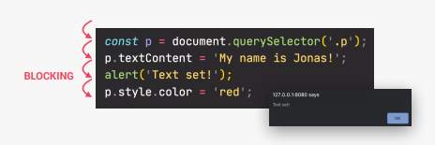
What is Synchronous?
Synchronous – code executed line by line. One after another, just as written.
Most of the code is synchronous
Each line waits for previous to finish
Problem: Long-running operations block code going forward

Slide 3

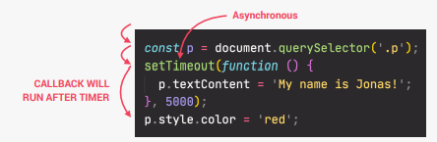
Asynchronous
If we use synchronous code, then sometimes we need to wait for long time on webpage which will look like it’s frozen!
We use Asynchronous code to avoid waiting for very long time for some part of code to finish

Slide 4

Asynchronous
Asynchronous code is executed after a task that runs in the “background” finishes
Asynchronous code is non-blocking
Execution doesn’t wait for an asynchronous task to finish its work
Callback functions alone do NOT make code asynchronous!

Slide 5
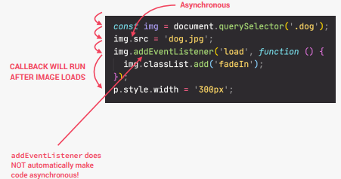
An example
Let’s load an image:
Now imagine that the image is very big and it takes long time to get it ready.
We don’t want to block the application, so we need to use async way
So we added async operation img.src, which will do this in the background
Then event listener will listen to event. Only when it is loaded, then callback will do something
Because this may take some time, the code goes to the next line

Slide 6
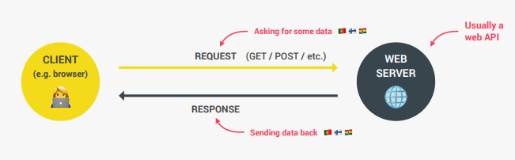

AJAX
Asynchronous JavaScript And XML
(often instead of XML we use JSON since it is more popular)
Allows us to communicate with remote web servers in asynchronous way
With AJAX calls we can request data from web servers dynamically.
We send request from our computer to Web server
Then we get response from Web server

Slide 7
API
In the previous slide we have shown something called API
API = Application Programming Interface
API is piece of software that can be used by another piece of software, and this way allows applications to talk to each other
One API we used so far: DOM API.
We can make them by ourselves or use those made by other people
There are millions of APIs out there

Slide 8
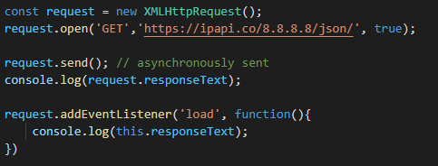
Let’s make first API call using AJAX
First let’s go and see that there are many public APIs on the internet. This link contains many of them we can use for our practice
We will use this one: https://ipapi.co/api/#location-of-a-specific-ip
Each API contains something called Endpoint. Basically URL which we can use
First we will use the old way:

Slide 9
What happens here
We create new XMLHttpRequest object
Then we send GET request to URL
We log the response to prove this is
asynchronous
We expect first log to be empty
Then we add the eventListener to show log when the data arrives

Slide 10
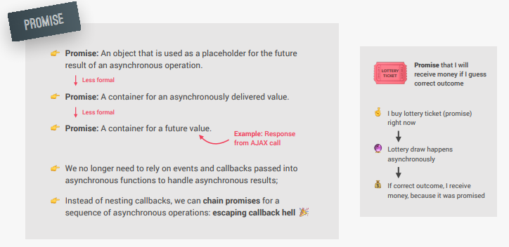
Promise

Slide 11
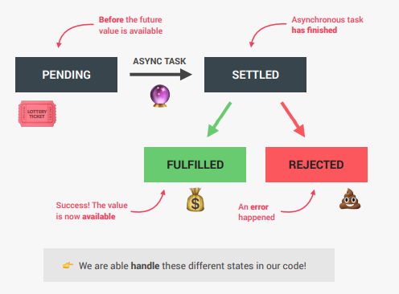
Lifecycle of Promise

Slide 12

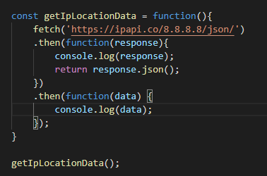
Using Promise
We make the function getIpLocationData() which we will call
Now function looks very complicated
We get promise if we just use the fetch like this, but we cannot use it’s response data
We need to wait for the response, so we use .then(function)

Slide 13
Using Promise
Inside of the function body of the first .then we will show what response do we get
We want to return response as result of this function so we can get it in the next .then section
Finally, we will be able to see the data in JSON format.
Now we can show data in the html elements
So let’s try it out.

Slide 14
Let’s use arrow functions
When using arrow functions code is going to look much cleaner and easier to understand:

Slide 15
Practice
Let’s find some open API and use it’s data to show on the screen
If we cannot find proper api, let’s use: https://rickandmortyapi.com/api/character/73

